Slide 1
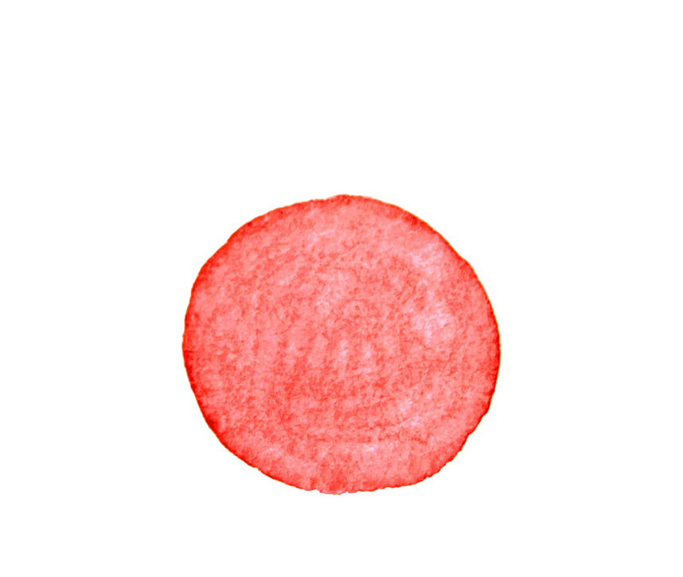

Slide 2
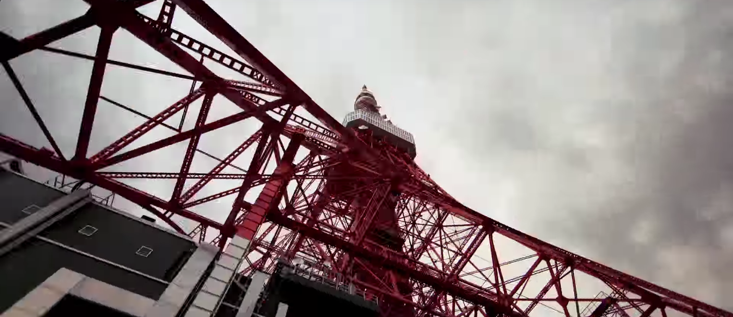
https://youtu.be/WLIv7HnZ_fE?t=78

Slide 3
People’s need for English
The Japanese begin learning English at the 5th grade level.
They continue learning it throughout high school.
Starting in 2020, English will begin to be taught at the 3rd and 4th grade level.
Because of the grammar-strict curriculum of Japanese schools, students often suffer.
Even though Japanese students begin studying English at an early age, and even though their English grammar skills may be advanced, their English speaking and conversational skills are often lacking and hinder them from becoming fluent.
This effect creates a demand for qualified native English speakers.
The 2020 Olympics has also energized the country to hone in on their English skills.

Slide 4
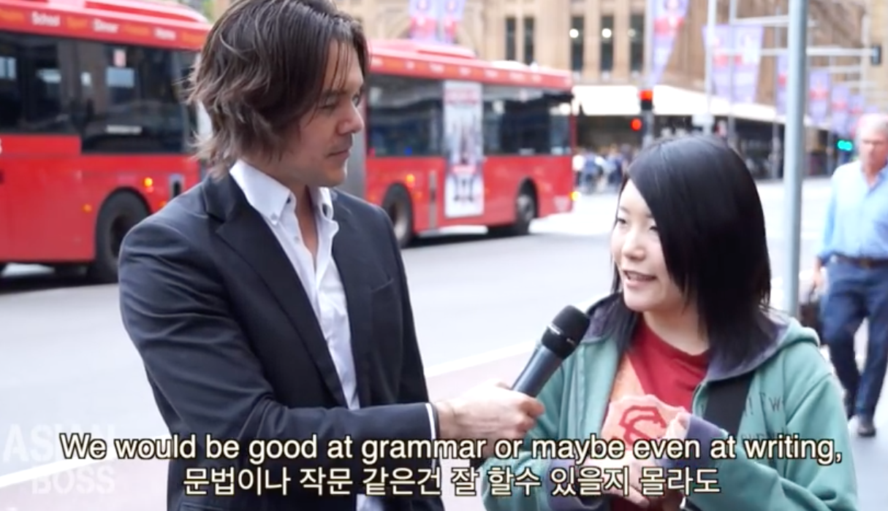
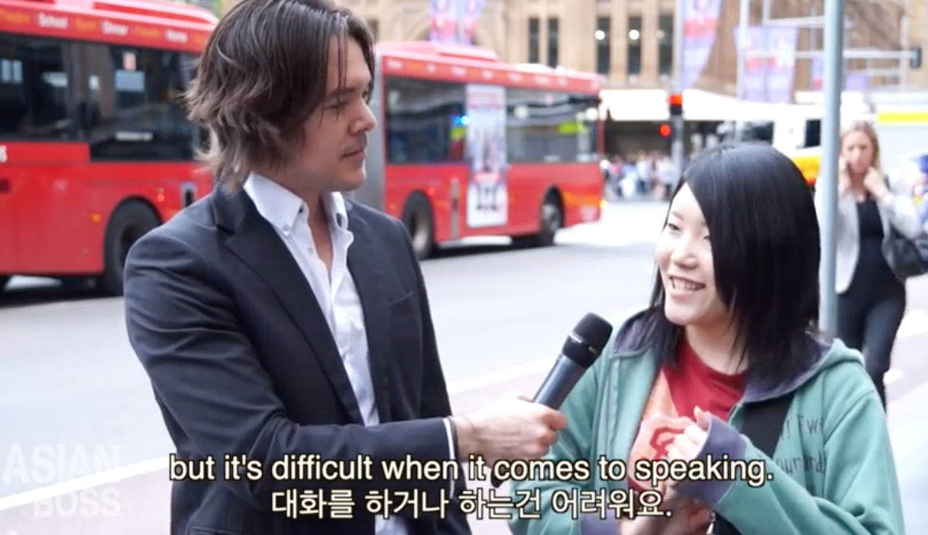
“Why Korean and Japanese Students Can't Speak English”
https://www.youtube.com/watch?v=wW920zWkIQI

Slide 5
“Last year the guidelines were further revised to start English education from the third grade as part of foreign language teaching, and make English a formal subject from fifth grade, starting in 2020, in an effort to enhance the nation’s global competitiveness.”
“The education ministry has also called for the number of English teachers to be increased, while hiring 20,000 native speakers and Japanese fluent in English as assistant language teachers by fiscal 2020.”
“The board of education of the city of Fukuoka has also tied up with the Fukuoka International School and has started English conversation classes specifically promoted to teachers. The lessons, taught by native speakers, are held once a week for an hour. Aid is provided for tuition fees. Roughly 400 people have attended the classes so far and about 80 percent of recent attendees are elementary school teachers, according to the board.”
.
“Aeon Corp., a major English language school operator based in Tokyo, said the number of elementary school teachers learning at their 250 schools nationwide has increased by about 8 percent in the last five years, with many of them saying they do not know how to teach the language.”
“To accommodate the future changes, the education ministry has come up with a five-year road map for providing training and raising “leaders” in English education at elementary schools in each of Japan’s 47 prefectures.”

Slide 6
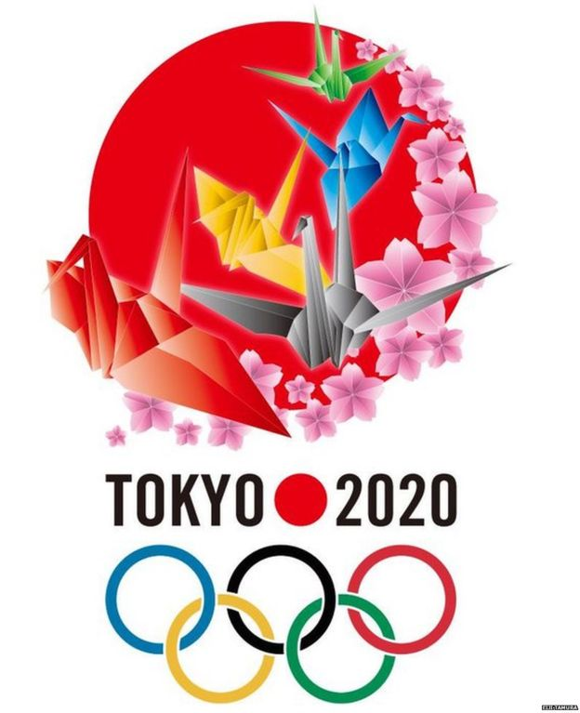
The Olympic Committee is looking to accept more than 90,000 volunteers in 2020.
Language learning students will gain the opportunity to practice what they have been taught.
“The Olympics is going to be an outstanding
experience for the students. They get to take
part in an international sports event.”
Takumi Okado, Kanda University of International Studies.
Some students will use the Olympic experience to begin a careers in the sports industry, such as in sports media or sports event organizing.

Slide 7
Japanese Public Education
Elementary School (小学校 shougakkou)
Six years long
After poor TOEFL test results nationwide (2nd lowest in East Asia), English instruction was mandatory (for grades 5-6) starting 2011 and foreign teaching has increased as a result.
Junior High School (中学校 chugakkou)
Three years long; the original starting point for English instruction among Japanese students
High School (高等学校 kotogakkou)
Three years long with more serious English instruction
NOT free, tuition depends on provincial government
High stress, high risk testing culture
Universities and Community Colleges (大学 daigaku, 短期大学 tanki daigaku)
Blend of traditional Japanese-style and Western instruction
English courses are usually compulsory

Slide 8
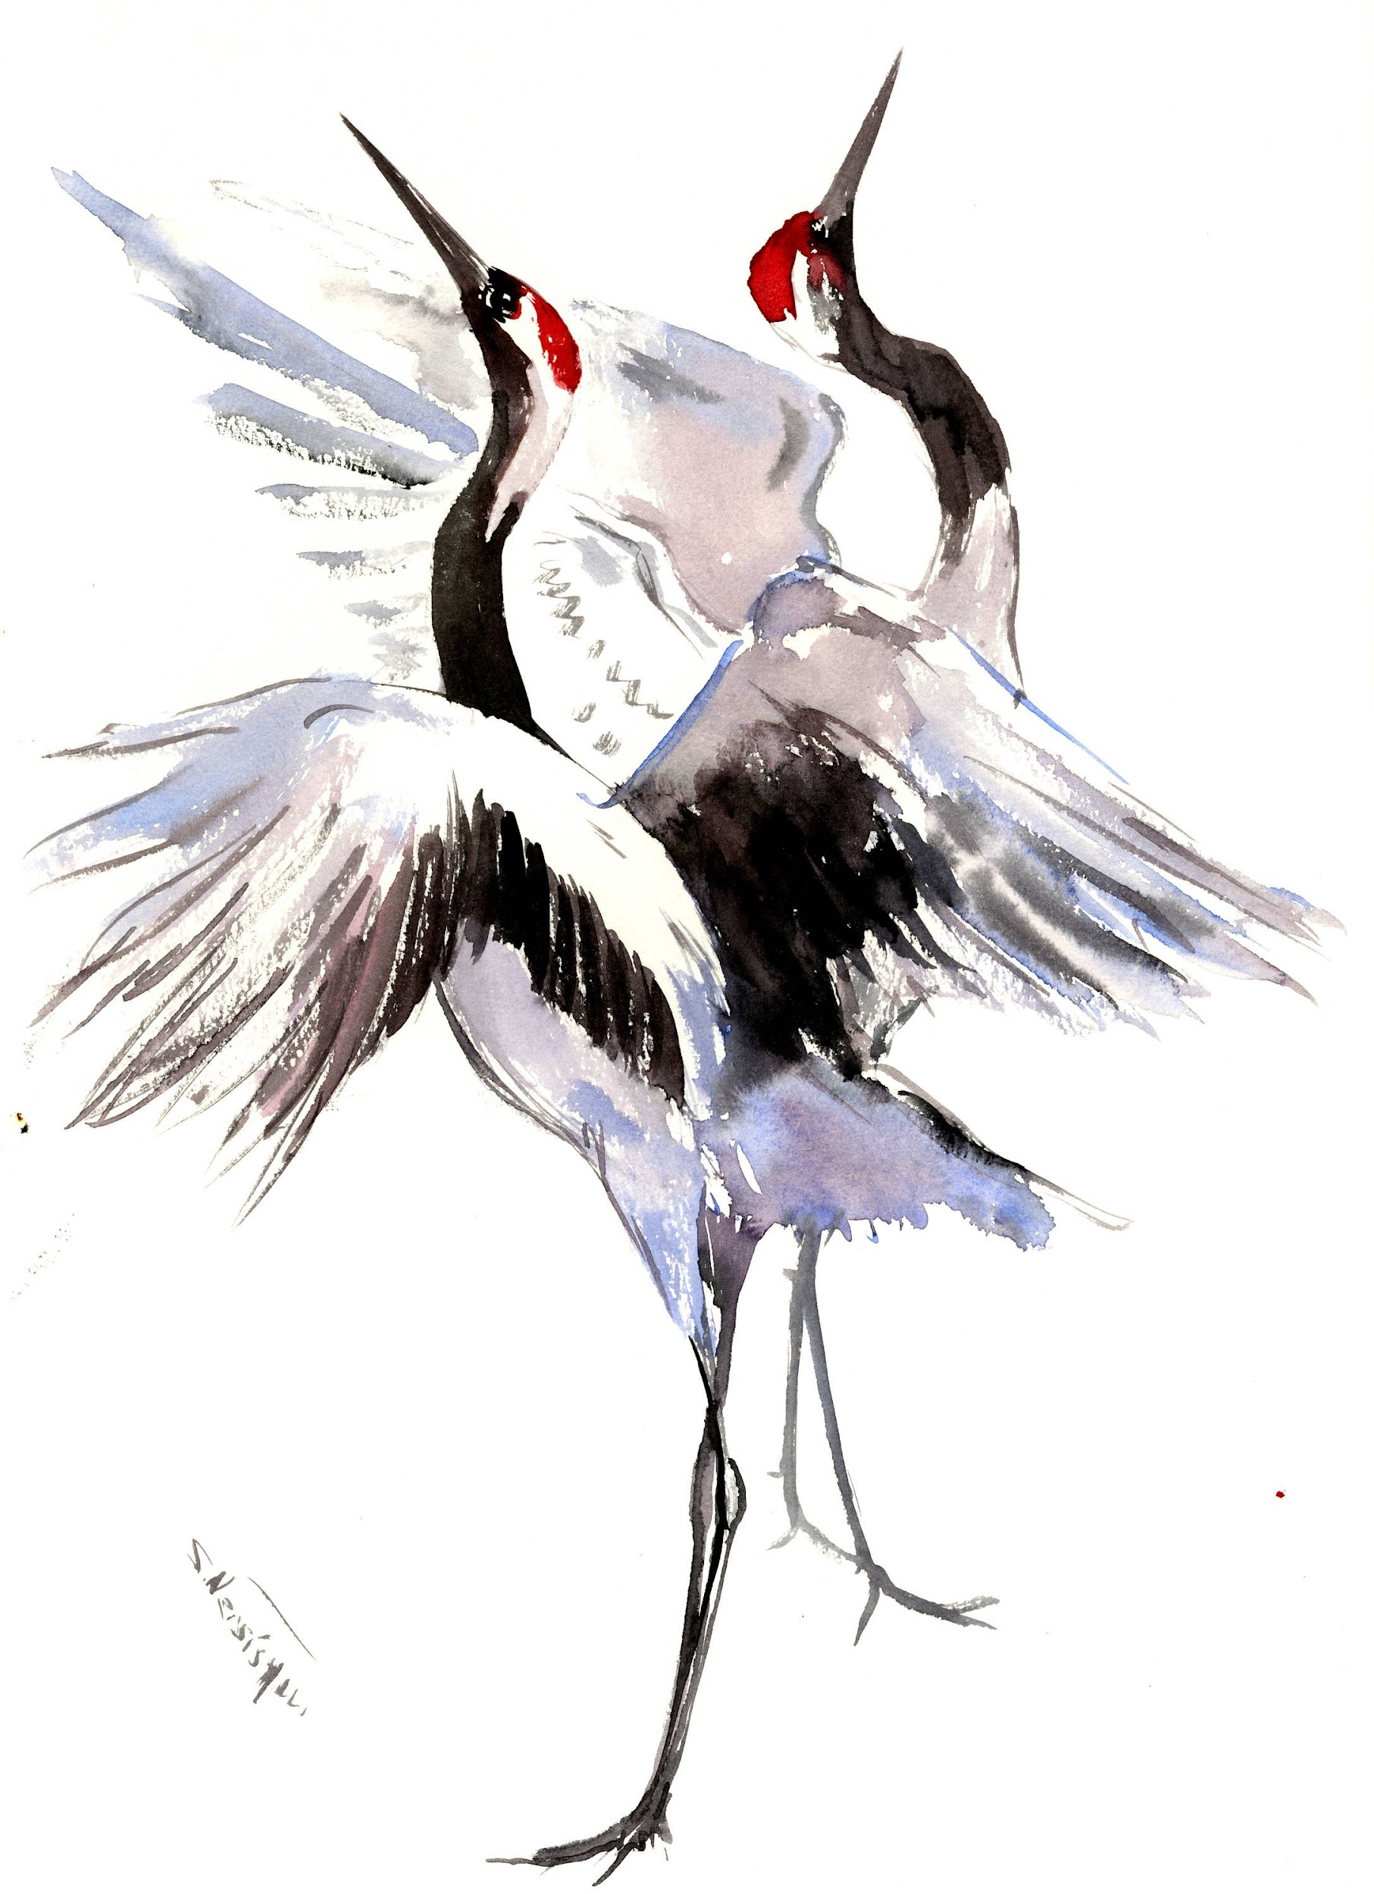
Your Role as a Foreign Teacher
ALTs
As a result of Japanese laws regarding mandatory English education starting from elementary school, quality ALTs are in need around the country.
Most jobs expect an ALT to function as the secondary teacher or play a supporting role to a native Japanese teacher.
Most English classes are administered in Japanese and while ALTs can provide linguistic support, they are usually there to spark interest in the students and motivate students to learn.
JETs have the additional expectations of international exchange within their communities.
Eikaiwa (英会話)
English Conversation schools, eikaiwa, have increased in popularity for Japanese students and foreign teachers since the 1990s.
Most native English teachers perform as both teachers and salespeople, since their employers are privately operated and the market is competitive.
Big chains in the cities are competitive work environments where success is demanded, smaller chains are at risk for closure during hard economic times.

Slide 9
Culture in Classroom
Class usually begins with the class bowing to the teacher.
Some schools provide a brief meditation period as well.
Japanese elementary schools
Students clean the classrooms, halls, and yards of their school in these teams.
The students eat lunch together in their classrooms, with their teacher.
Young children tend to be tolerated to a greater extent, especially when they misbehave.
Elementary school homework. (https://www.youtube.com/watch?v=QTMPHzeD2n0)
Most middle and high schools require students to wear uniforms.
Boys generally wear pants and jackets with stand-up collar.
Girls wear two-piece suit with sailor collar or blazers and skirts.
Extracurricular activities become available starting at middle school.
Such as a sports team, a musical or arts group, or a science club.
Sleep tolerance (High School)
Because of the strenuous nature of Japanese schools, particularly in high schools, the understanding and tolerance for students sleeping in class is much higher than in the U.S.

Slide 10
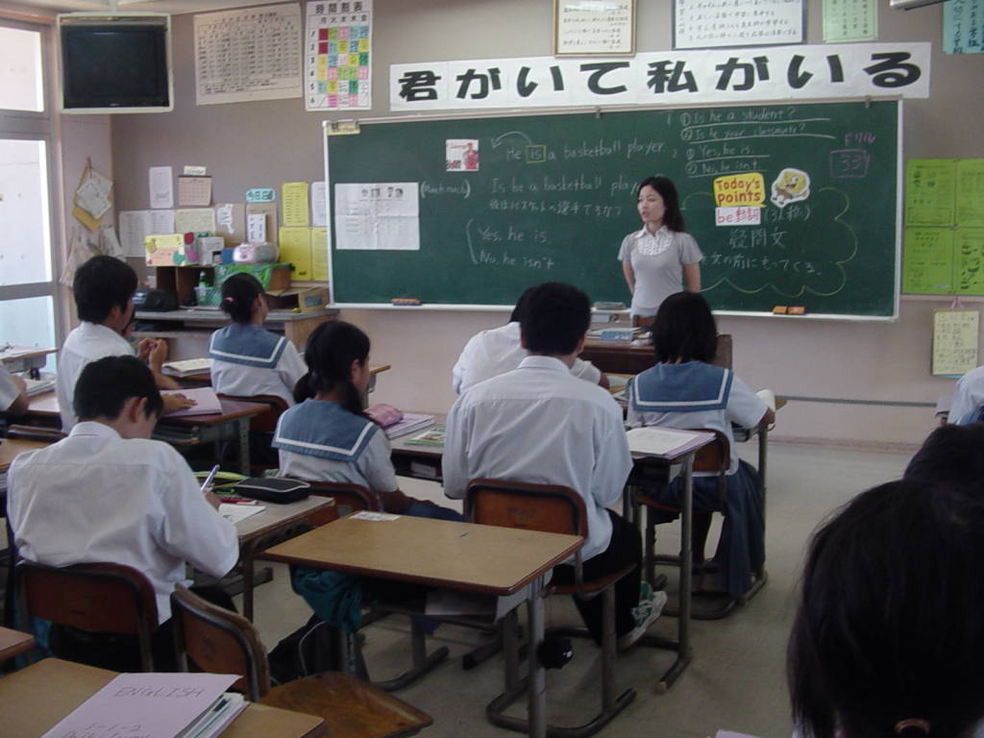

Slide 11
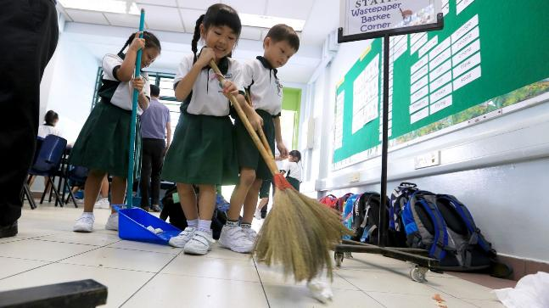
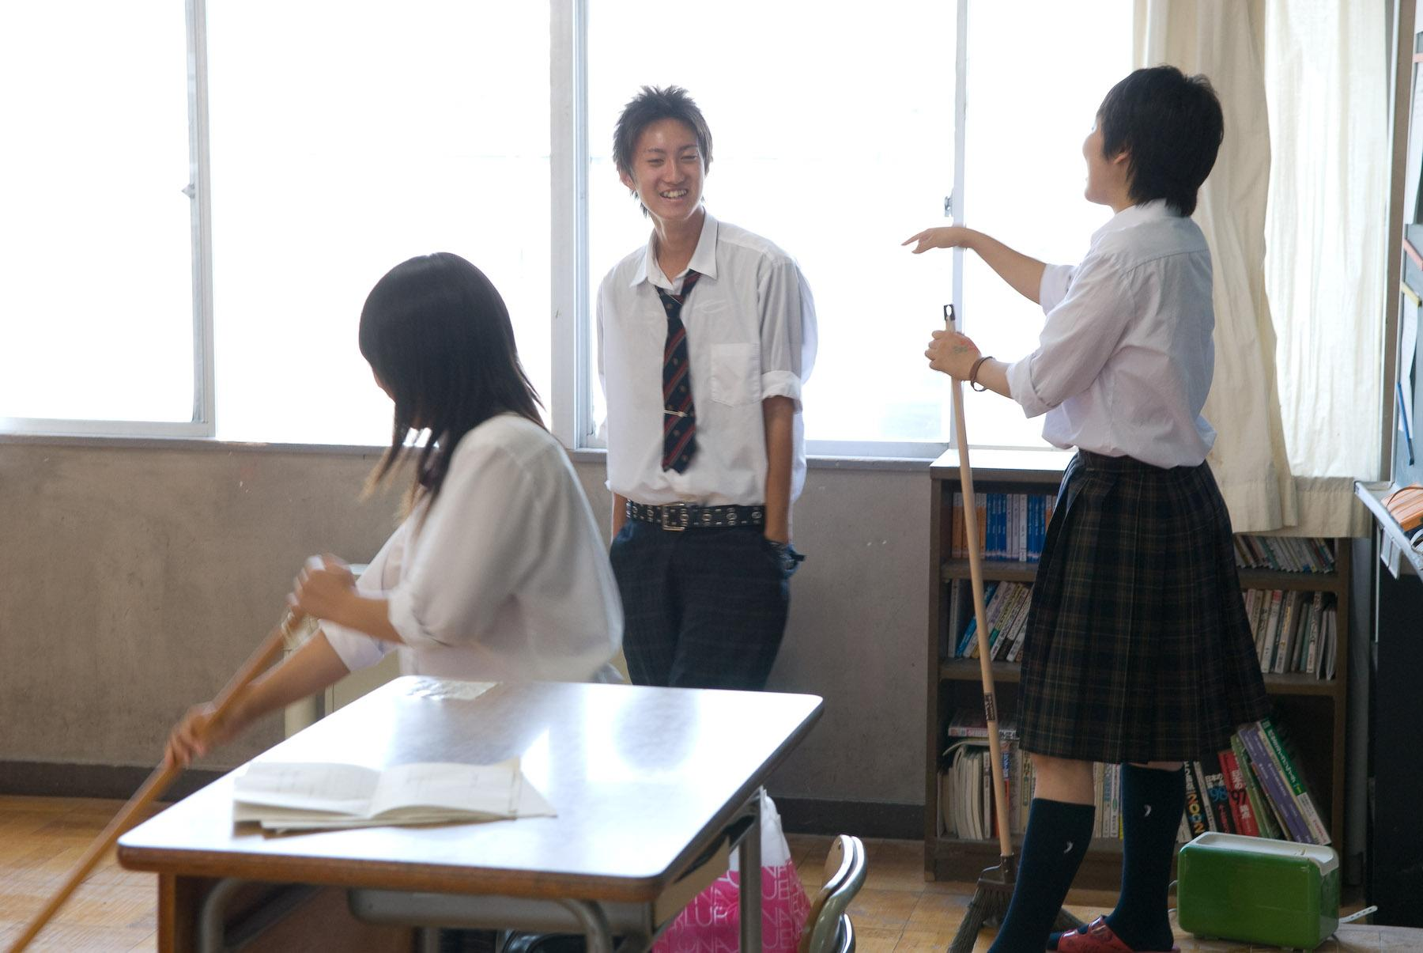

Slide 12
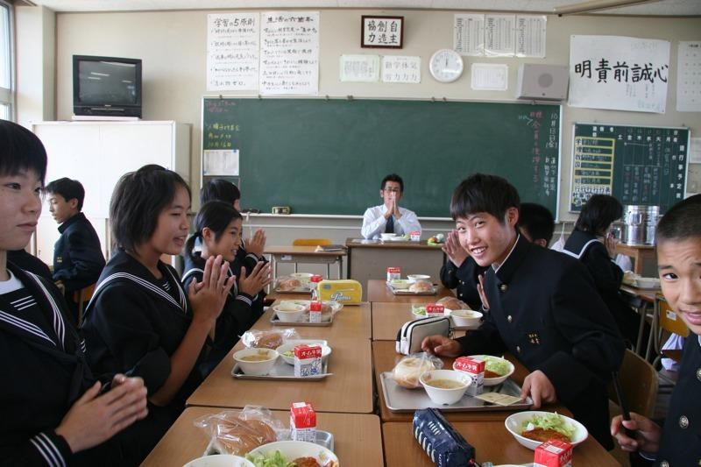

Slide 13
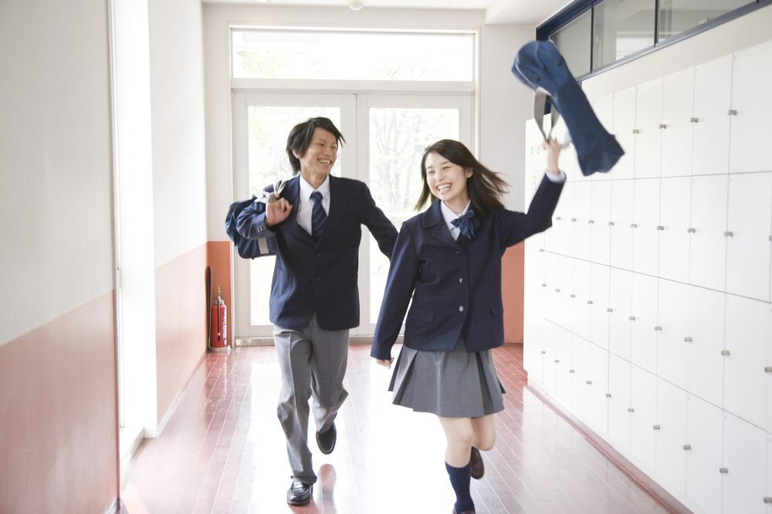

Slide 14
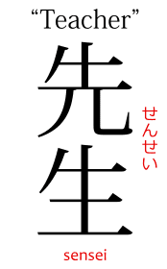
Culture in Classroom
Foreign teachers may provide a different use than a traditional teachers. (If administration allows it)
A friendly personality and friendly atmosphere.
A personalised touch, such as being responding to student needs.
Providing a model for the language.
Help with pronunciation .
Cultural information
Genuine interaction with a foreigner.
Students asking questions (and admitting that they don’t understand)
Because of the collectivist culture of Japan, some students become afraid of not wanting to stand out so they hide that they are either too fluent or not properly understanding something.
Modesty
Some students may not ask if they think they should go up a level, nor will they mentioning their previous achievements in English, such as high notes or study abroad experiences.
True Feelings
The Japanese are known for often hiding their true feelings in consideration for the feelings of others.This is often known as honne ( 本音 ) and tatemae ( 建前 ). However, in a classroom setting, it is considered that the right thing to do is to be as honest as possible with students.

Slide 15
Employment
Work either as an ALT or an Eikaiwa
Assistant Language Teacher (ALT) in a public or private school
Eikaiwa (英会話) (private English school) teacher
Average starting salary: 247,700 JPY ($2,250) per month
Salary remains consistent regardless
JET program: 280,000 JPY, ($2,550 per month) with yearly pay increases. Housing provided.
Some teachers can make more than that depending on his/her qualifications & previous teaching experience.
More experienced teachers can potentially earn anywhere from 300,000 to 650,000 Yen ($2,700 - 5,900 USD). For these positions, a higher degree is often required.
UniversitIes
Japanese international schools.

Slide 16
Employment
Airfare and housing costs are typically not included
Schools often assist in finding housing
Schools will also occasionally provide housing stipends
The average monthly cost of living: 193,500 JPY to 296,000 JPY ($1,700 - $2,600).
English teachers usually benefit from:
Free return flights
Work visa sponsorship
Health insurance (some eikaiwa may illegally leave you to pay for insurance and welfare yourself.)
Heavily subsidized (or sometimes free) housing
Some paid vacation (most vacation time and breaks are usually unpaid for entry-level positions.)
Transportation costs may be covered by your employer.
Japan can range anywhere from 25 - 35% of your take-home pay. However there are more affordable cities in
Japan such as, Kanawasa, Hiroshima, Nagano, Nagoya, Kobe and Kyoto.
The cost of living in the bigger cities in Japan is usually higher than in other Asian countries like China and Korea.

Slide 17
References and Sources
Why Korean and Japanese Students Can't Speak English | 한국과 일본학생들이 영어 못하는 이유 | 日本人や韓国人が英語を話せない本当の理由 https://www.youtube.com/watch?v=wW920zWkIQI
https://www.internationalteflacademy.com/teach-english-in-japan
https://www.internationalteflacademy.com/faq/bid/102201/how-large-is-the-job-market-for-english-teachers-abroad
https://www.japantimes.co.jp/news/2018/03/13/national/native-english-speakers-demand-japanese-teachers-hone-language-skills-new-curricula/#.XA9VHKeZPwc
https://www.japantimes.co.jp/news/2017/01/06/national/japan-aims-overcome-language-cultural-barriers-2020-games/#.XA-B3KeZPwc
https://www.internationalteflacademy.com/faq/bid/118318/what-are-salaries-for-english-teachers-in-japan
https://www.teachaway.com/blog/how-much-money-can-you-make-teaching-japan
https://www.gooverseas.com/blog/salary-expectations-for-teaching-in-japan
https://zoomingjapan.com/life-in-japan/eikaiwa/
International City Rankings (2017) https://docs.google.com/spreadsheets/d/1CcmZSiedjGraHk0jSPTSH2g55-Bafhk9DDr8oDn-Yqg/edit?usp=sharing
https://www.numbeo.com/cost-of-living/rankings.jsp
https://web-japan.org/kidsweb/explore/schools
https://www.tefl.net/elt/articles/home-abroad/cultural-differences-japan/
Teaching in Japan: 5 Useful Tips for Beginners https://www.youtube.com/watch?v=q31KskoimGw

